Slide 1
CREDIT SCORE CLASSIFICATION
By Mahmoud Said

Slide 2
Overview
Introduction
EDA Process
Modeling

Slide 3
Introduction
Problem Statement You are working as a data scientist in a global finance company. Over the years, the company has collected basic bank details and gathered a lot of credit-related information. The management wants to build an intelligent system to segregate the people into credit score brackets to reduce the manual efforts.
Task
Given a person’s credit-related information, build a machine learning model that can classify the credit score.

Slide 4
Dataset
100000 Record
28 Features
From Kaggle

Slide 5
EDA PROCESS
Business and data understanding.
Using df.info () check the datatype of columns.
Univariate analysis for features to check errors
Check for duplicates in your data and remove it.
Clean the data by fixing the errors using apply function and try except.
Repeat step 4.
Apply feature engineering if possible.
Check for missing values and handle them first try to remove columns that have a lot of missing values then try imputation techniques or dropping rows.
Repeat step 4.
Detect outliers and deal with it .

Slide 6
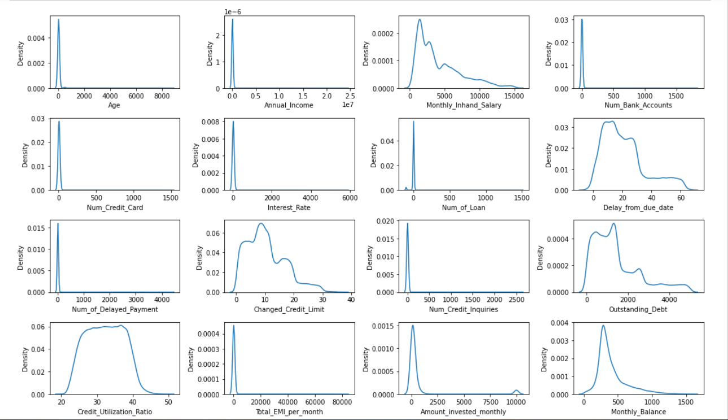
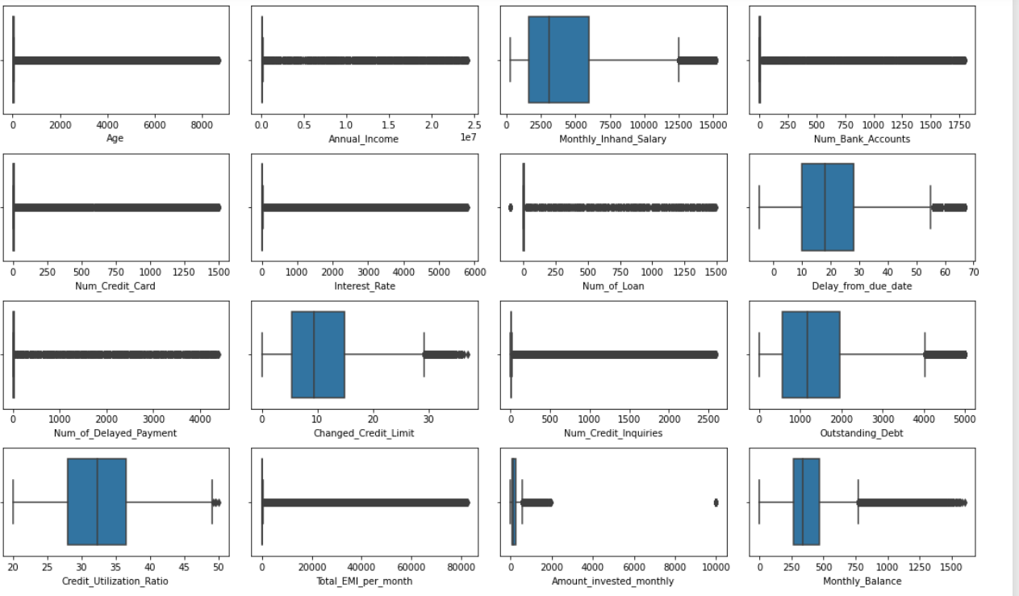
Univarate analysis for numerical feature
Kdeplot tell us distribution of Features
Boxplot tell us outliers in the Features

Slide 7
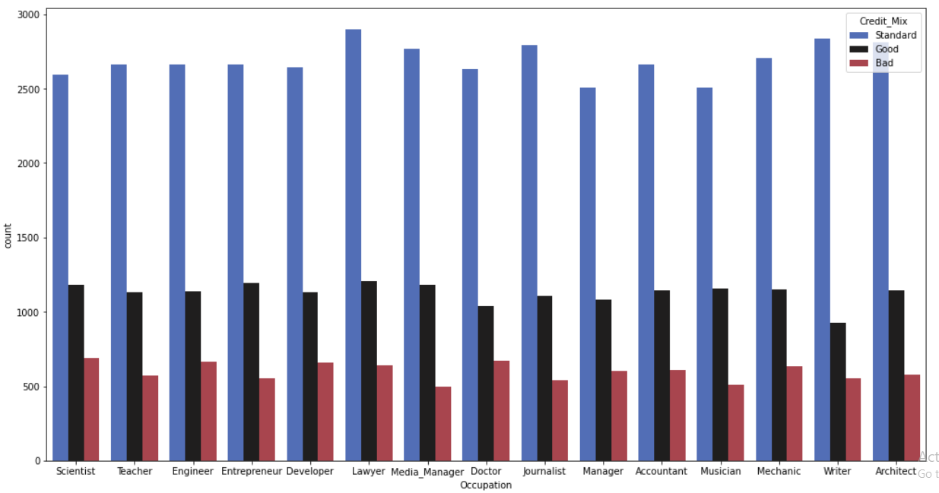
Bivariate analysis for categorical features

Slide 8
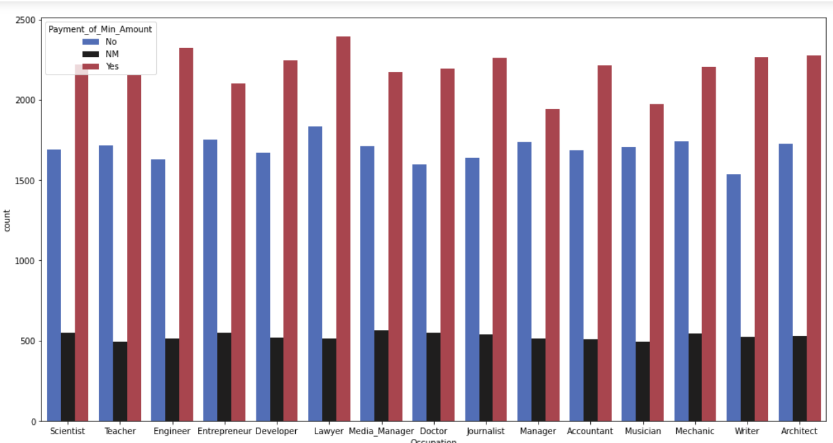


Slide 9
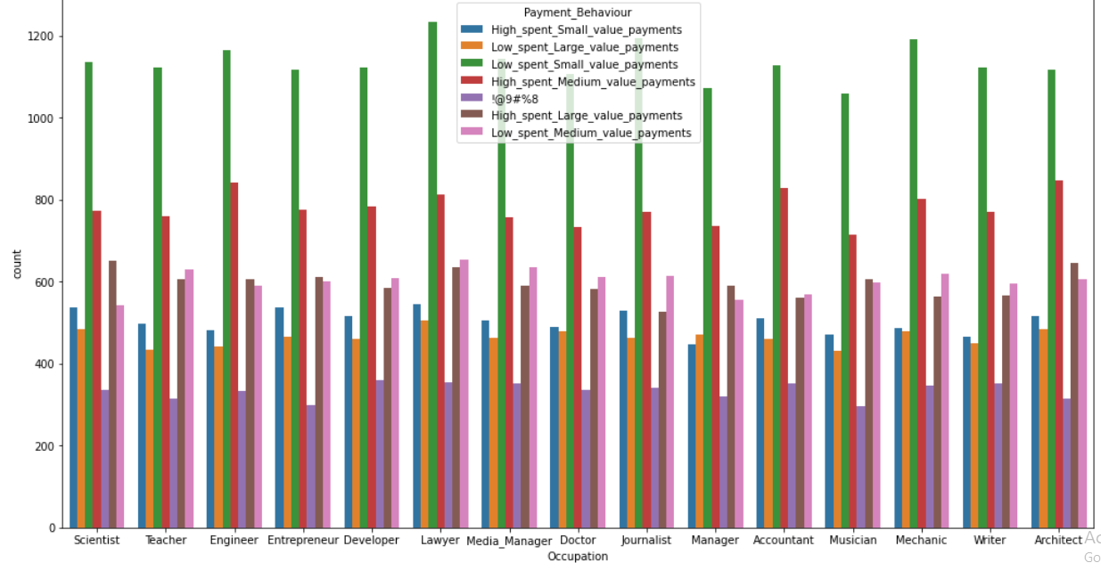

Slide 10
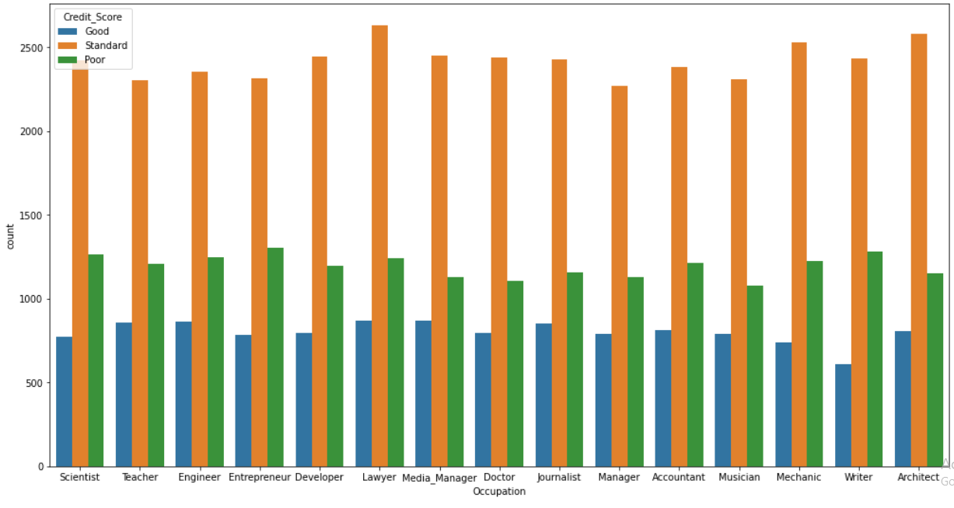

Slide 11
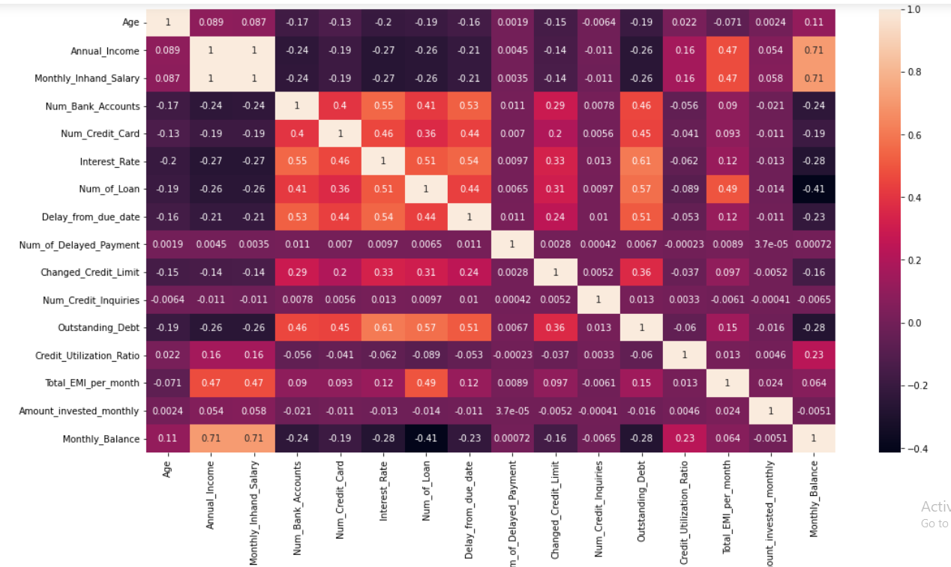
Bivariate Numerical Analysis
Correlation between numerical feature and other

Slide 12
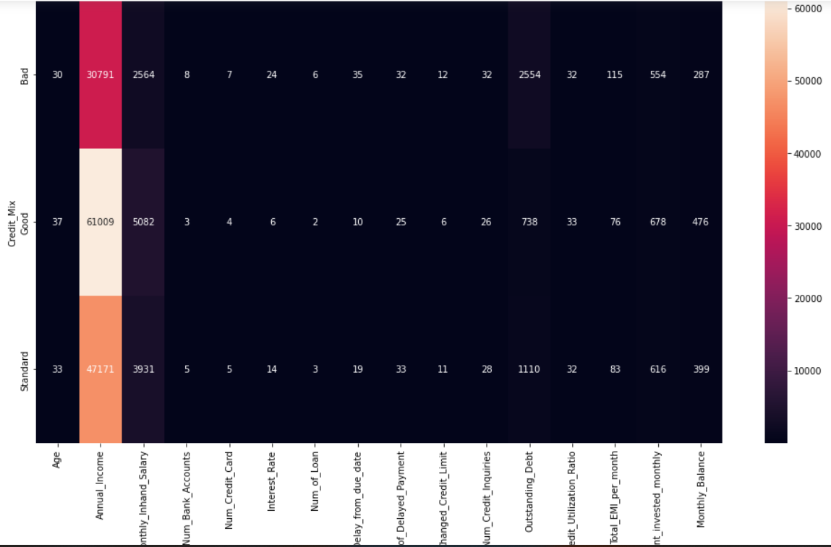
Bivariate Numerical With Categorical Analysis

Slide 13
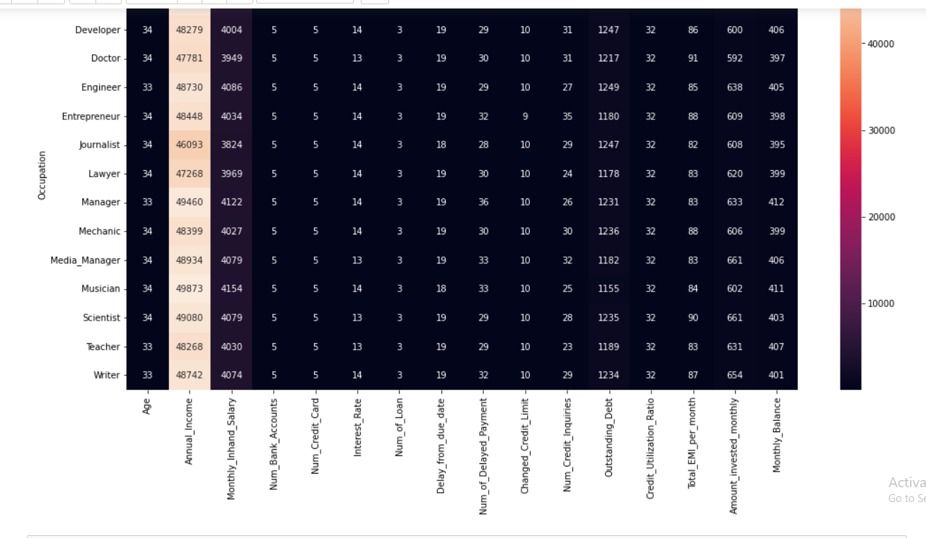

Slide 14
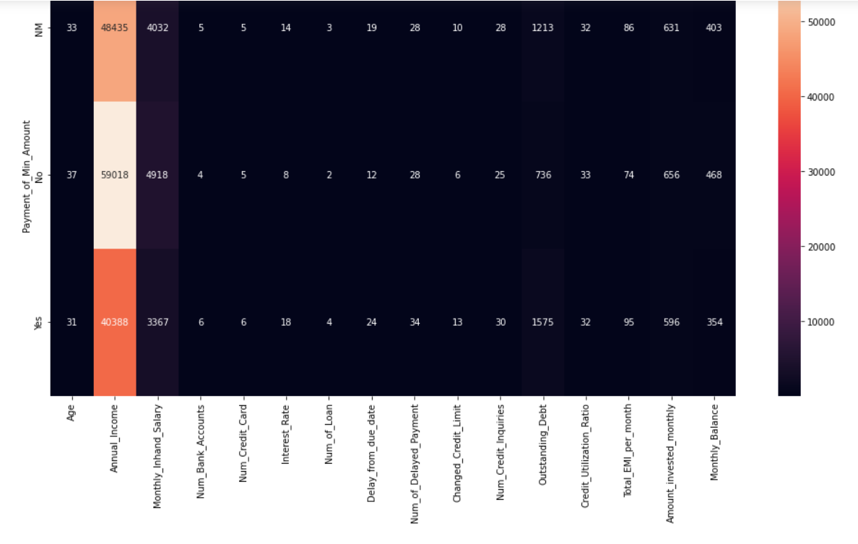

Slide 15
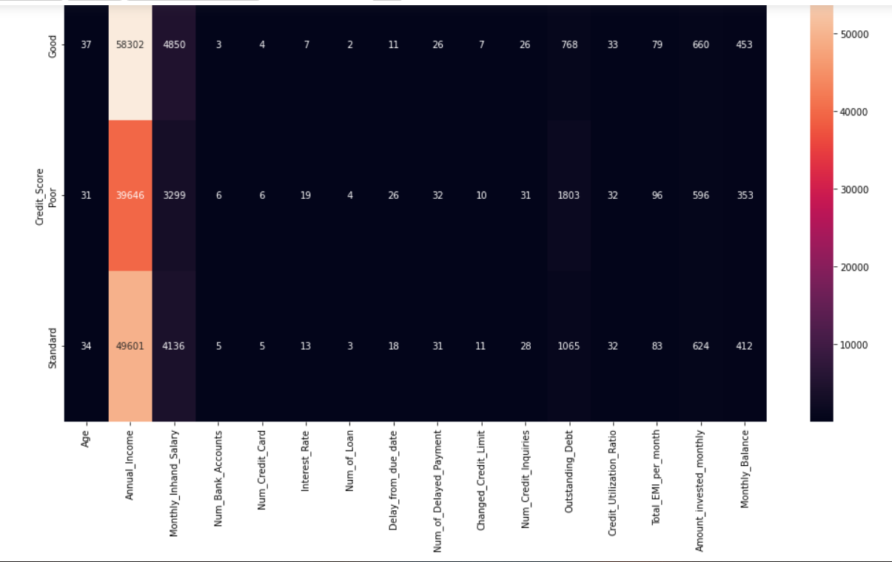

Slide 16
Classification Algorithms
Logistic Regression
knn
DecisionTree
Naive Bayes
Svm
Random Forest
AdaBoostClassifier
XGboost

Slide 17
Models
Algorithms | Accuracy
Logistic Regression | 0.66
Knn | 0.68
Naive Bayes | 0.65
XGboost | 0.72
AdaBoostClassifier | 0.68
DecisionTree | 0.70
Svm | 0.66
Random Forest | 0.79

Slide 18
Tools
NumPy
Matplotlib
Seaborn
jupyter
Pandas
Scikit-learn
Streamlit

Slide 19
Any Question?

